Slide 1
Air Quality Index Predictions
1
So your events’ participants are always happy

Slide 2
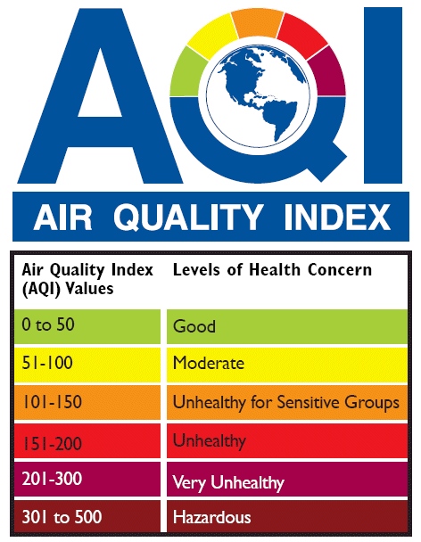
Why is the Air Quality Index important for you
2
Health Dangers
Unpleasant for Participants

Slide 3
What we took into consideration
3
Cloud Cover & Rain Precipitation
Temperature
Humidity and Visibility
2500 rows of data
Wind Speed and Direction
Pressure

Slide 4
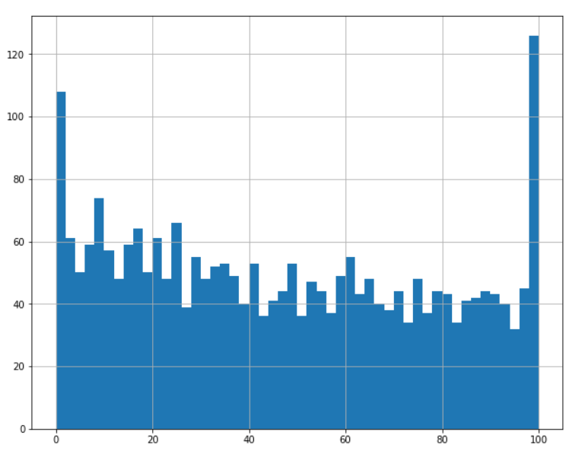
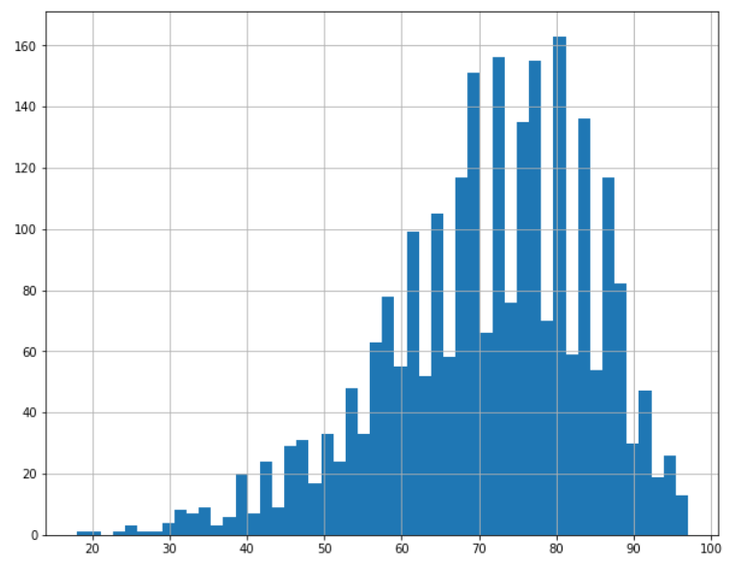
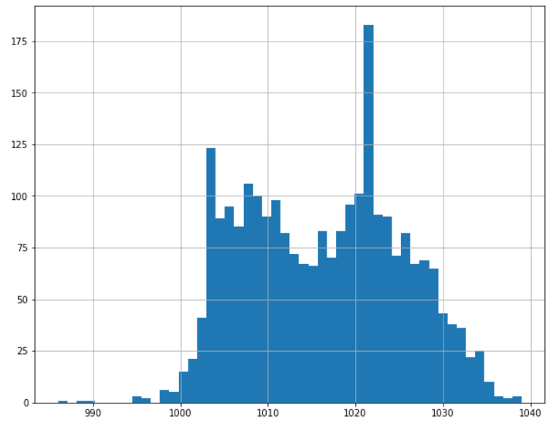
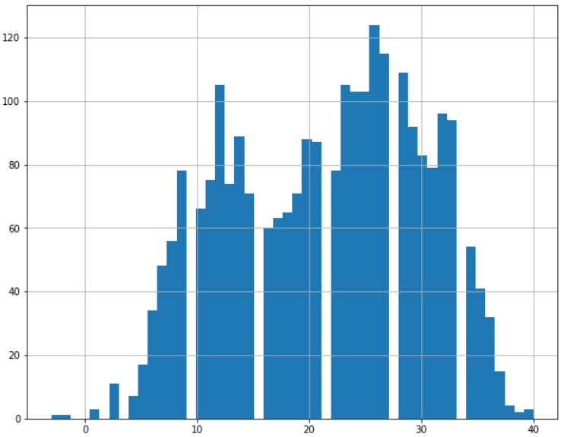
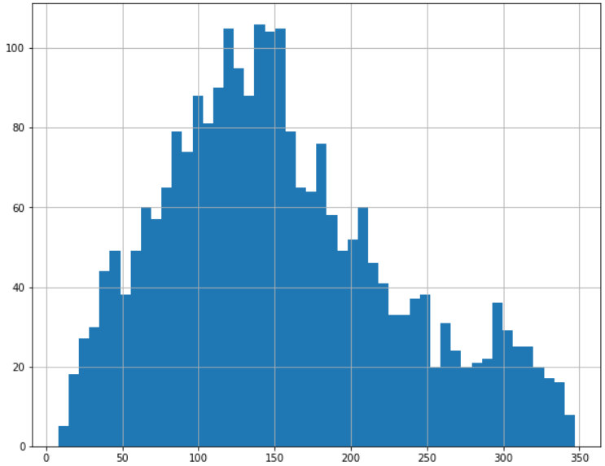
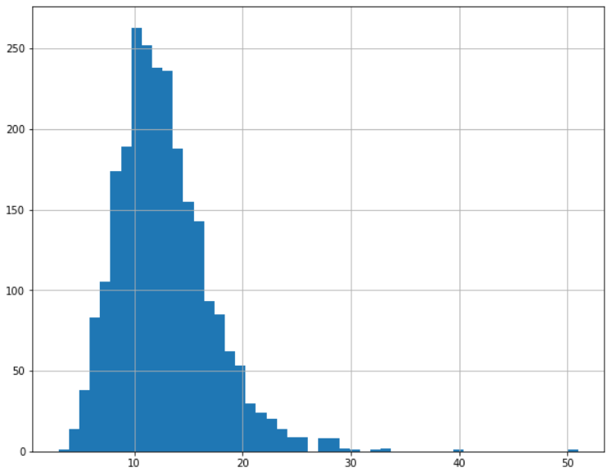
Data Density
4
Cloud Cover
Humidity
Pressure
Temperature (C)
Wind Direction (Deg)
Wind Speed (Kmph)

Slide 5
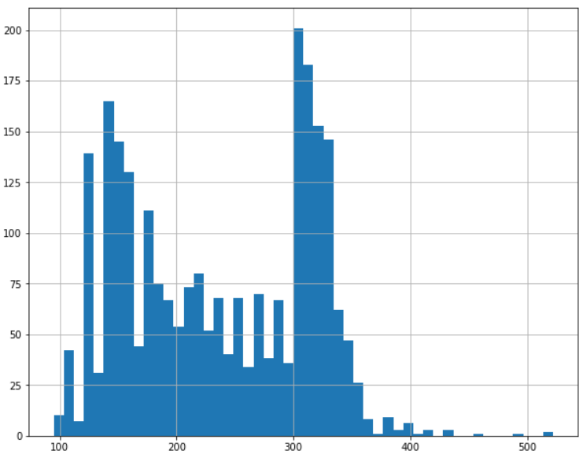
Air Quality Index Data
5
Air Quality Index Density
Percentages of safe and unsafe AQI
39%
61%
We considered “unsafe”
all the values over 200

Slide 6
The Model
6
50% | 13.5%
13.5% | 23%
True Negative
False Positive
False Negative
True Positive
73% Accuracy

Slide 7


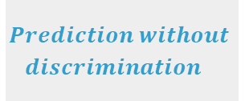
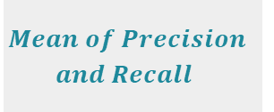
Other Metrics
7
$$\frac{TP}{TP+TN}$$
63%
Recoil
$$\frac{TP}{TP+FP}$$
63%
Precision
F1
$$Mean of Precision$$
$$and Recall$$
63%
$$Prediction without$$
$$discrimination$$
71%
AUC

Slide 8
All you have to do
8
1
Just check the 8 values for that day
2
Use our model
3
Know whether to host an event or not

Slide 9

9
$$Thank you for your attention$$

